Slide 1
Project 4 - Hiring Process Analytics

Slide 2
Project Description
In this project we are trying to analyse the past hiring data of a company and identify the trends like how many men and women were hired or rejected, which department has the maximum number of employees and which one offers the highest salary etc. We are going to use a powerful software known as Ms-Excel in order to find out the answers and built different interactive charts for the same.

Slide 3
Approach
First we have to download the dataset and open it in Ms-Excel. Then we analyse the various columns and check if any blank values are present and if some values have been wrongly represented. To answer the different question we have to use pivot tables for each of them and then built the corresponding charts so that they are visually appealing.

Slide 4
Tech-Stack Used
Software used - Ms-Excel 365
This software is required as we have the given dataset in xlsx format and so we are able to analyse it using excel and build the charts using the same.

Slide 5
Project Excel Sheet Link
https://docs.google.com/spreadsheets/d/1JDmVFG3orxPe9c46Uz_pNByOYqpjiSWr/edit?usp=sharing&ouid=106513403342357132422&rtpof=true&sd=true

Slide 6
Insights :

Slide 7
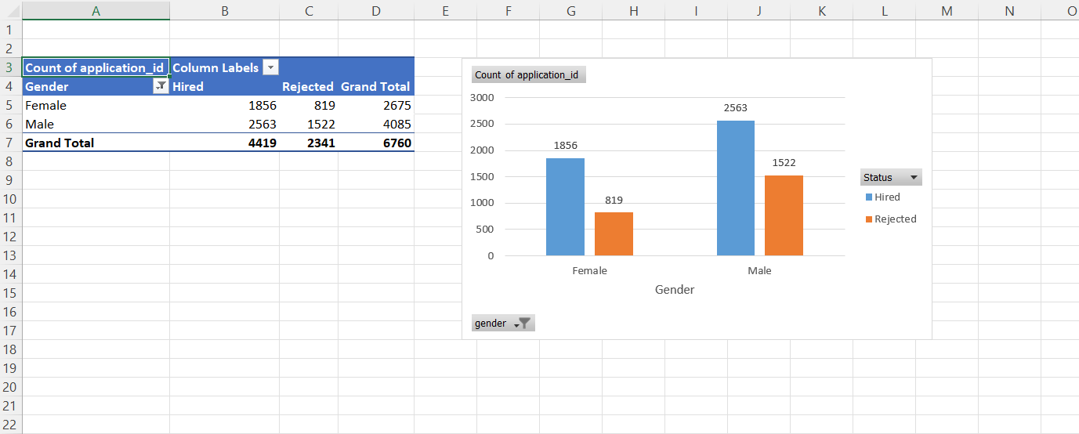
Hiring - We are trying to identify the no of males and females who have been hired. We get the conclusion that the no of males that are hired are more than the no of females.

Slide 8
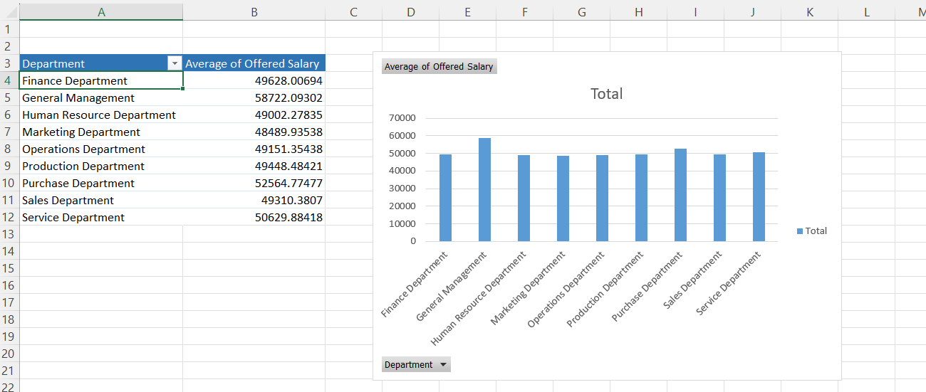
Average Salary - We have used the pivot table to find the average salary of the employees for each department. From the column chart it is seen that ‘General management’, ‘Purchase Department’ and ‘Service Department’ have the average salary greater than 50000.

Slide 9
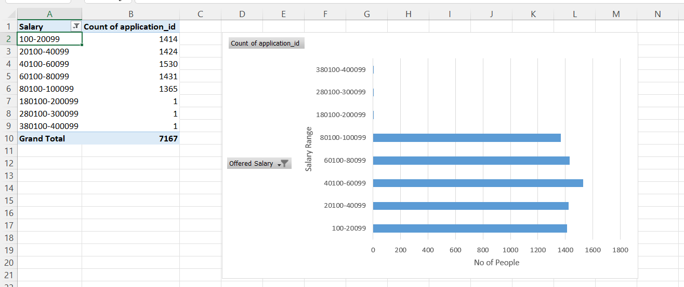
Class Intervals - Using pivot table and the group function we have created the class intervals of for the salary column. We have taken the class intervals to be 20000. It is observed that more number of people are present in 40100 - 60099 range.

Slide 10
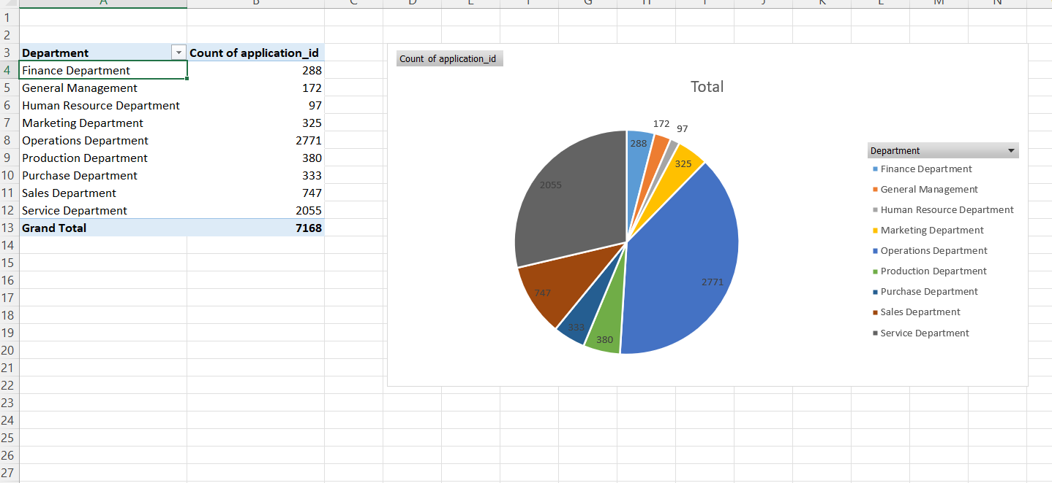
Charts & Plots - Here we have show the no of people hired with respect to each department and it has been visually represented using the pie chart. The maximum hiring have been done for the ‘Operations Department’.

Slide 11
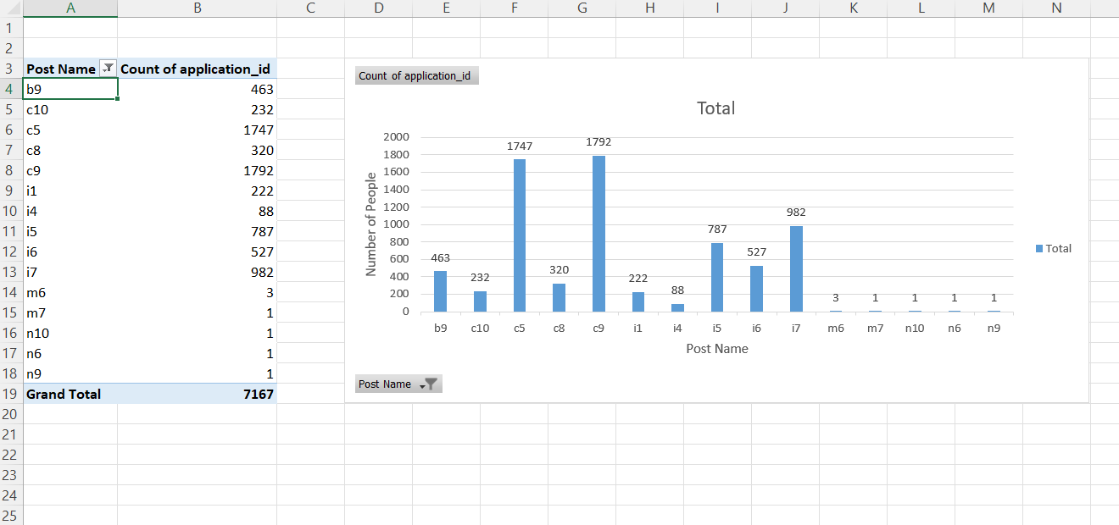
Charts - We identify how many people are present for each category of ‘Post Name’ . It is seen that for ‘c5’ and ‘c9’ the number of people hired are maximum.

Slide 12
Result
While analysing the above dataset for hiring analytics we came to conclude different types of question like how many males and females were hired overall, what was the average salary for each department and which department had the highest average, the salary range which had the most no of people, then a pie chart representing the proportion of people in each department and finally a bar chart representing the count of people in each post. Through this project we have learned about the pivot tables and the various charts we can build from the data of the pivot table.

